Slide 1
Introducing ART UCSF’s Application, Review and Tracking (ART) System
July 2015

Slide 2
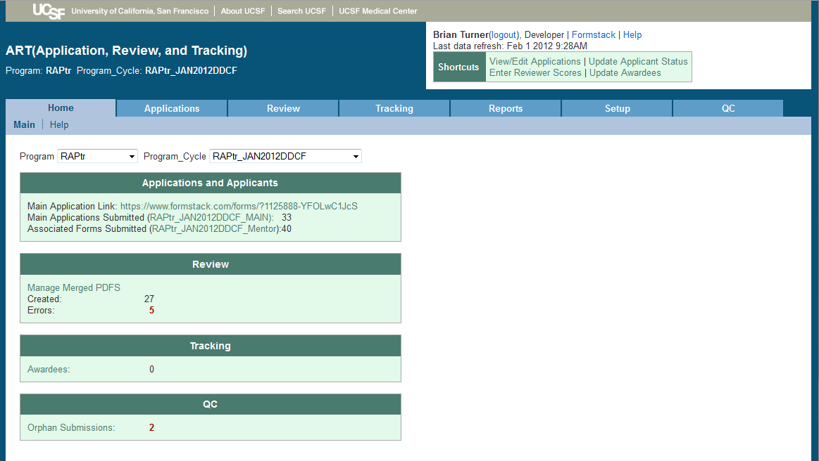
Contents
What is ART?
Overview
User Perspectives/Process Steps
Contact

Slide 3
What is ART?
ART is a software package that streamlines and centralizes the APPLICATION processes typical in many funding and training programs.
ART replaces the numerous emails, faxes, spreadsheets and scanning usually associated with REVIEW of applications.
ART gathers data from application to post-completion, allowing for comprehensive TRACKING of program participants.

Slide 4
What is ART?, Continued
ART is a hosted solution, co-developed by CTSI, SOM Office of Student Research and the SF Coordinating Center
Data stored on UCSF Epi/Biostat servers
CTSI and SF Coordinating Center provide user support
ART couples an off-the-shelf form builder (Formstack) with a database and user-friendly screens to provide a flexible, comprehensive product.

Slide 5
What is ART?, Continued
To use ART, a program must:
Understand that ART is designed to solve a specific workflow associated with application processing and following up with participants.
Have a tech-savvy project administrator to utilize all the benefits of ART
Get MyAccess for their Reviewers if online review is to be used
Allow their data to be hosted by UCSF Epi/Biostat
NOT suitable for HIPAA-protected data

Slide 6
Origin
Challenge: administrative inefficiencies across funding and training programs.
Use of multiple emails, spreadsheets, fax, scanners, websites, phone calls and online forms to complete application process
Solution: build a user friendly, data-focused system that leverages existing software where possible.

Slide 7
Current Usage
1000+ Applications across 9 programs processed since Oct 2010
100+ users to date including program administrators, faculty, staff
Interest from others on campus
Programs across UCSF, as well as within CTSI have expressed an interest in using ART

Slide 8
ART is Designed to:
Allow customizable forms for collecting data
Streamline many administrative tasks
Centralize data collection
Reduce data re-entry: online review and scoring
Allow for integrated, ongoing follow-up data collection
Enable easy, flexible reporting and data export
Integrate with UCSF federated log-in system

Slide 9
ART is Not Designed to:
Support large, complex review processes
Send mass emails to program applicants or prospects
Replace in-house program database(s)
Perform any financial functions

Slide 10
How You Use ART Depends on Who You Are
Applicants
Faculty Mentors / Recommenders
Reviewers
Program Administrators

Slide 11
Applicants’ Steps
Applicant clicks link from program email or program information website.
Link takes applicant to online application form, see next slide. No login is needed.
- Note: Application forms can be tailored to each program.
Applicant completes and submits form, including uploading PDF attachments (CV, proposal, budget, etc), if necessary.
ART system automatically sends confirmation email.
Applicant checks personalized portal for application status and program announcements.

Slide 12
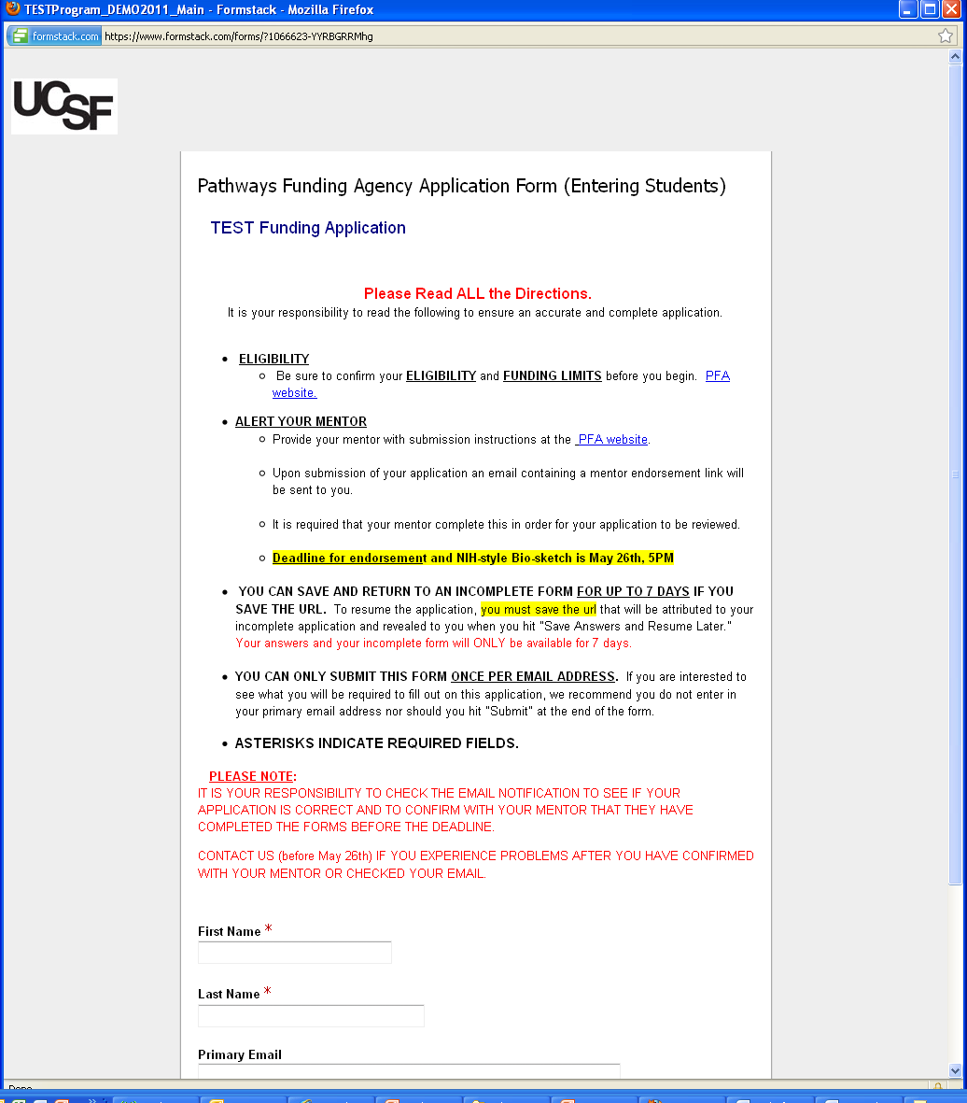
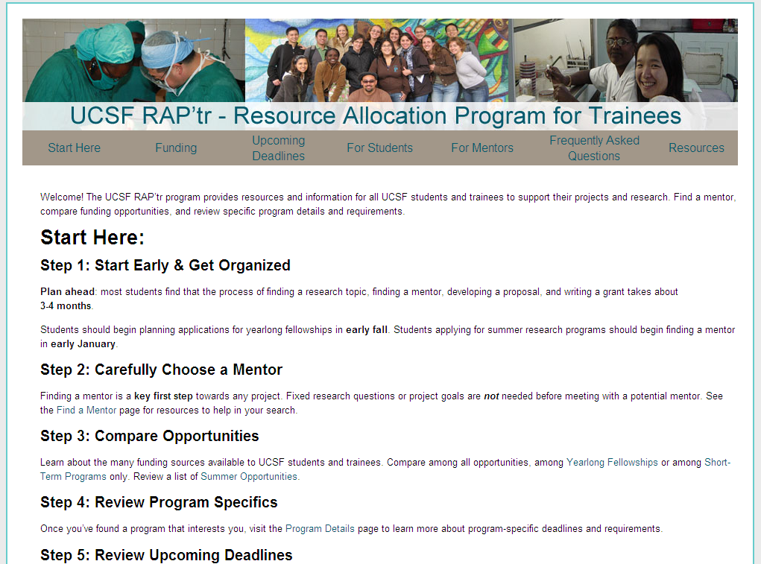
Applicants’ View / Application
Example: A link to the application on RAP’tr website would open online application form in ART system.

Slide 13
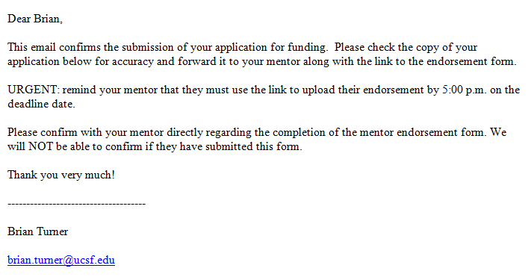
Applicants’ View / Confirmation Email
Dear Nick,
Thank you for completing your application to the CTSI Education program. Here is a link to your personalized portal where we have posted your submitted application and will post other relevant program information. Please bookmark it or keep it handy.
https://art.epi-ucsf.org/ApplicantPortal.aspx?pdf=3706157983706272
If information on your portal appears incorrect, please contact me at the email below.
Best regards,

Slide 14
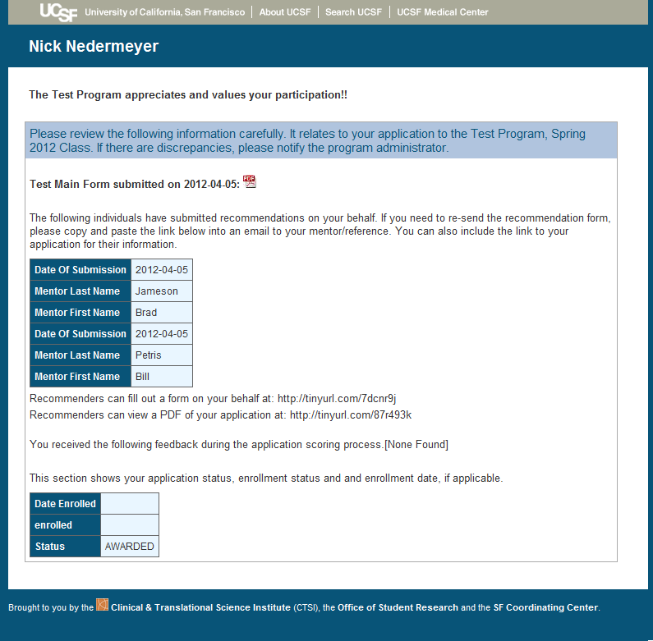
Applicant Portal

Slide 15
Faculty/Mentors’ Steps
The mentor/recommendation process is optional – some programs do not require recommendations.
Mentors (or faculty writing recommendations) receive a link via an email to complete online recommendation form.
- Typically email with link is sent from Applicant to their mentor.
Mentors complete and submit the online recommendation form.
Note: Recommendation forms can be tailored to each program.
ART system will seamlessly add mentor recommendation to application packet for review

Slide 16
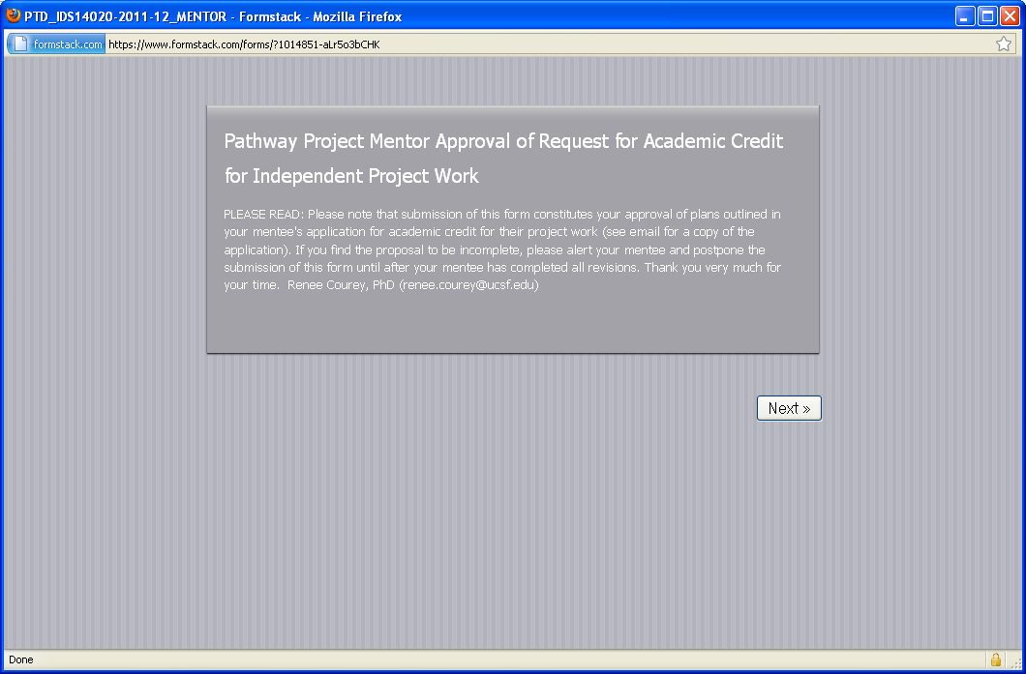
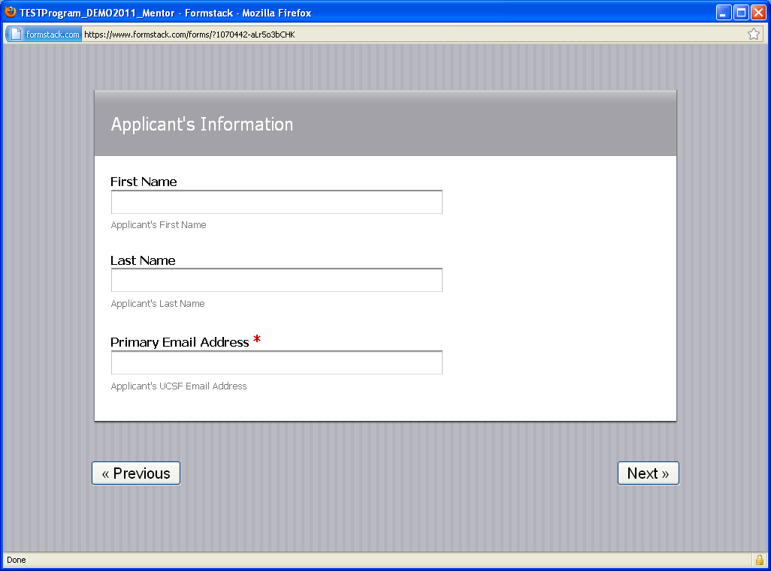
Mentors’ Complete Recommendation Online

Slide 17
Reviewers’ Steps
Reviewers log in to ART to read application packets and score them.
Reviewer views a PDF of the full application packet for each applicant.
Reviewer submits scores online for each applicant via tailored online scoring forms.
Scores and comments are automatically added to the applicant’s record in the ART system.
If needed, administrator can enter/change scores on behalf of reviewer.

Slide 18
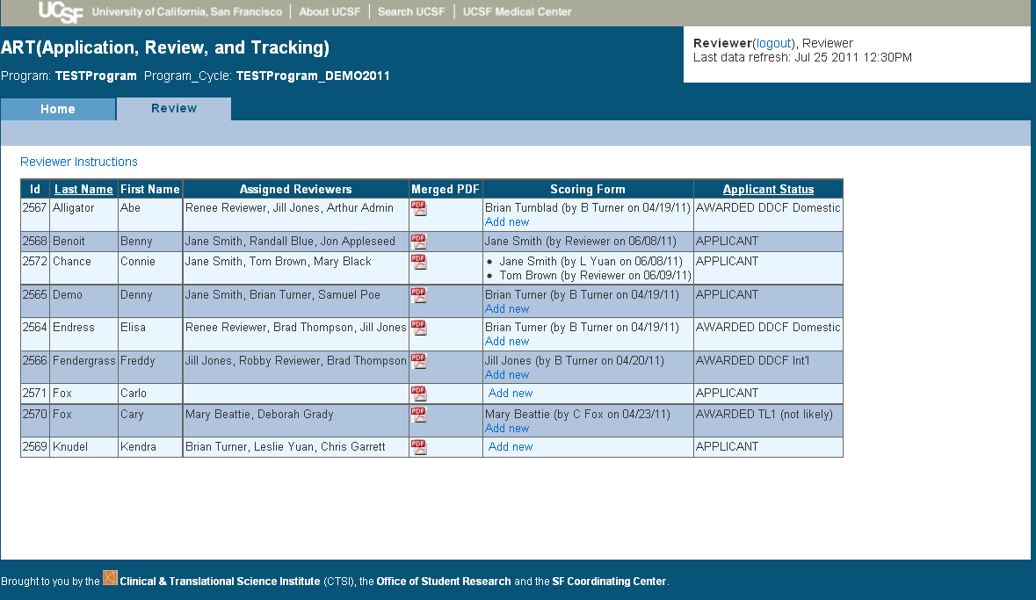
Reviewers’ View / Online Scoring
Click here to full view application packet
Click here to access online scoring form

Slide 19
Program Administrators’ Process
Log in to process applications, manage reviews and generate reports.
- Also can set up new cycles, troubleshoot submitted forms and manage the entire award process
Keep track of the applicant record, including status in the program, mentor and reviewer names, notes to other admins, etc.
Create and send follow-up surveys to gather and report on participants’ career progression.

Slide 20
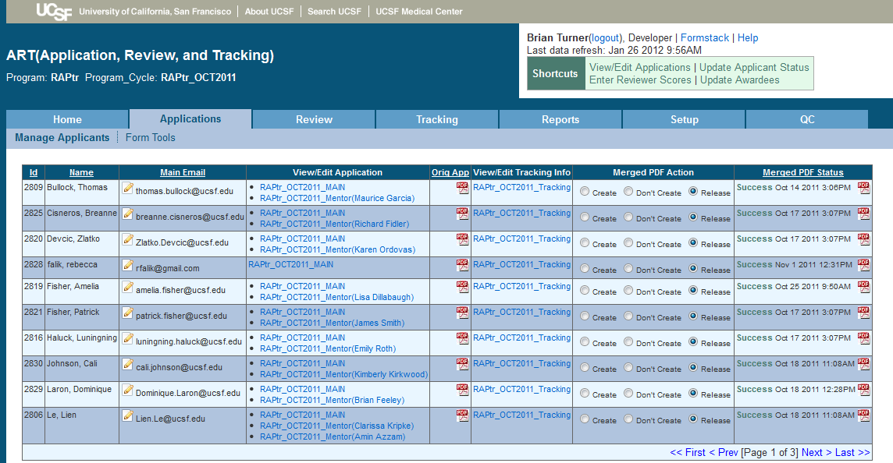
Administrators’ View / Application Processing

Slide 21
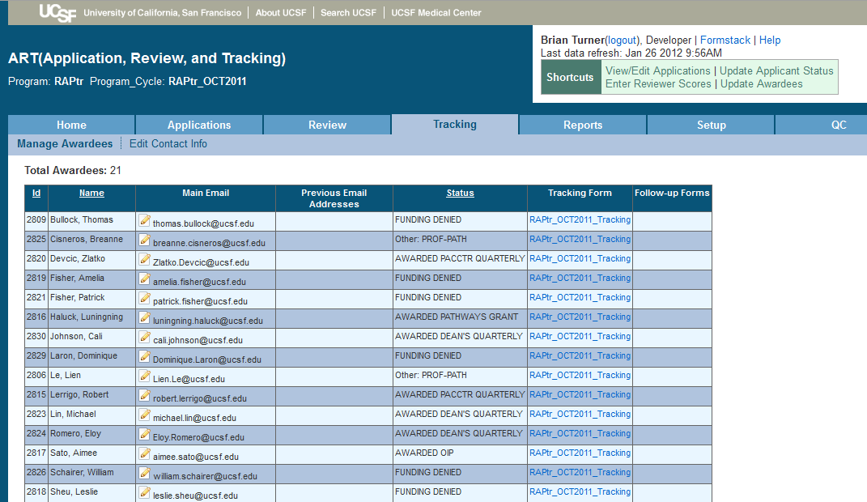
Administrators’ View/Tracking Applicant Status

Slide 22
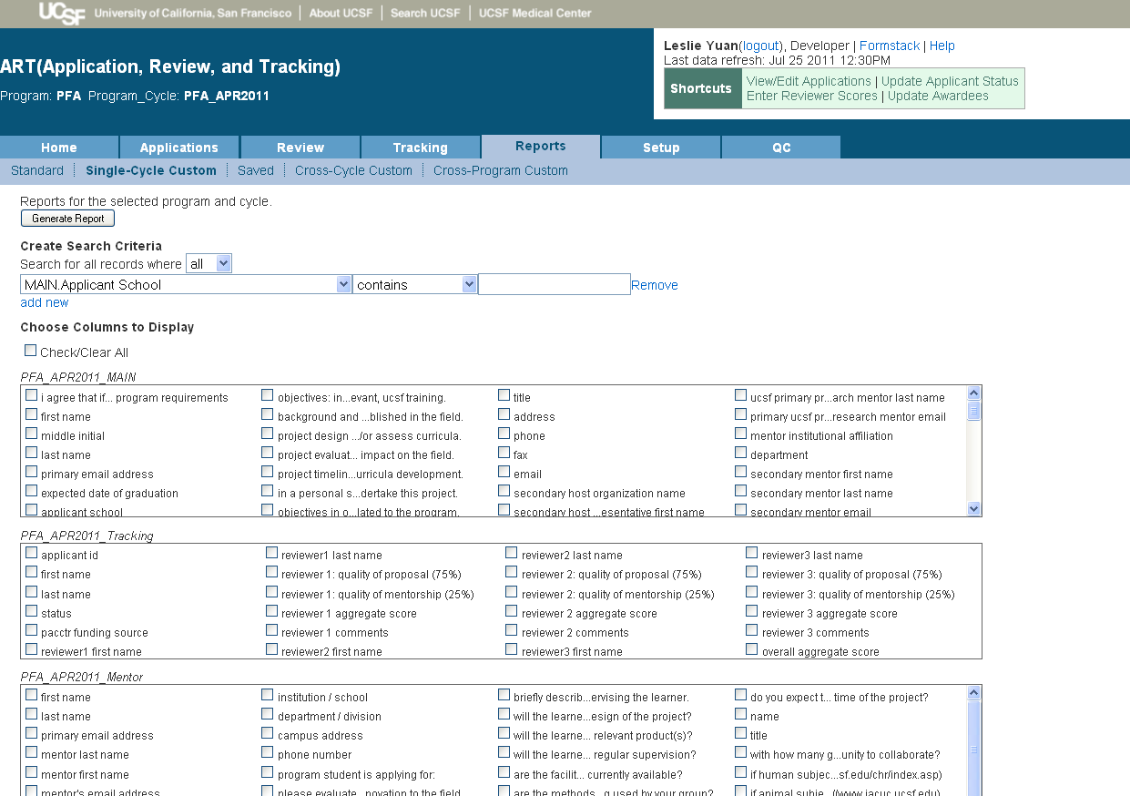
Administrators’ View / Generate Reports

Slide 23
Long-Term Tracking/Follow Up Surveys
ART supports custom surveys to participants
Anonymous surveys for feedback
Career follow-ups linked to applicant record
Leverages already-captured applicant data for comprehensive reporting
Assesses program impact and career progress
Reporting is customizable
Supports exporting data as .csv file for use with an external database or Excel
Presents comprehensive view of participants, across all cycles in a program

Slide 24
Questions?
Contact:
Brian Turner
ART Product Manager
brian.turner@ucsf.edu
http://art.ucsf.edu

