Slide 1
Network Infrastructure Projects
Wireless Network Refresh
Frank Guerra IT PMO

Slide 2
Statement from Project Charter
The wireless networks supporting the UCSF enterprise have grown over the last 10 years from independently managed team and departmental installations to the centrally managed enterprise solution. This wireless expansion project is intended to “correct and unify wireless for the future”.

Slide 3
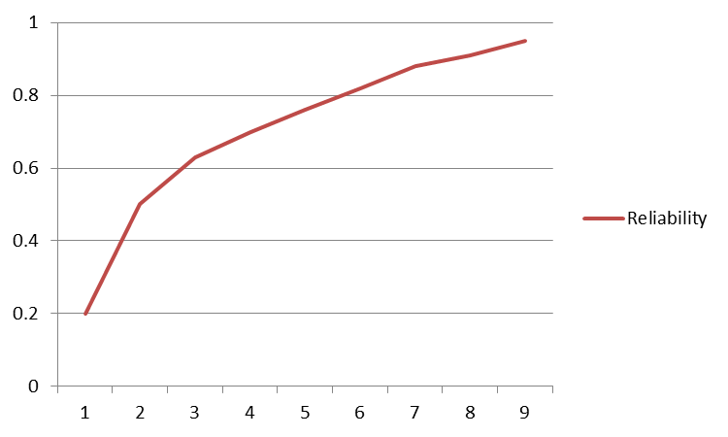
Project Goals
Enterprise Solution
Wall to Wall Coverage
Improve Reliability
Single Vendor Standard
… plus other improvements
Notes:
Increase Wireless Performance
Address Spotty Wireless Connectivity
Eliminate Drops in Wireless Connection
Migrate from Departmental Solutions
Improvements at the controller
Provide a platform for new applications
Eliminate rogue wireless networks

Slide 4
Approach
DESIGN
AP Layout Floor Plans
Heat Map
REVIEW
Impact Assessment
APPROVALS
SFM Review and Stamp
Equipment Specs
Infrastructure Survey
Department Communications
BUILD
CLOSE
Procurement
Installation
Turn-up
Cabling
Post-cutover support
Decomm Legacy Devices
Remediation

Slide 5
Technology Direction
Wireless Network Roadmap
Legacy
Location Relevant Content and Services
802.11b
802.11g
802.11n
Current Standard
802.11ac
Bluetooth Low Energy Beacons
Next Gen
802.11a
Notes:
Bluetooth Low Energy Beacons
Enable location aware mobile apps
Provide indoor turn-by-turn navigation
Location relevant content and services
Personalized guest experience
ClearPass

Slide 6
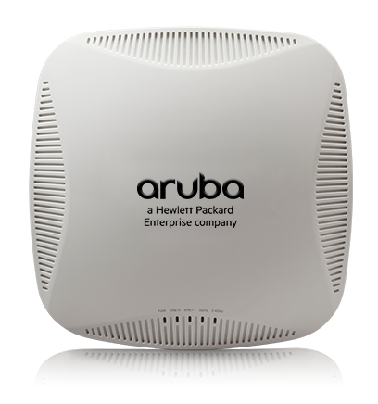
Current Standard Overview
Managed by Aruba mobility controller
Operating at 1.3 Gbps in the 5-GHz band and 600 Mbps in the 2.4-GHz band, these three-stream APs are up to three-times faster than 802.11n APs.
Replaces Cisco wireless access points and older generation Aruba wireless network devices

Slide 7
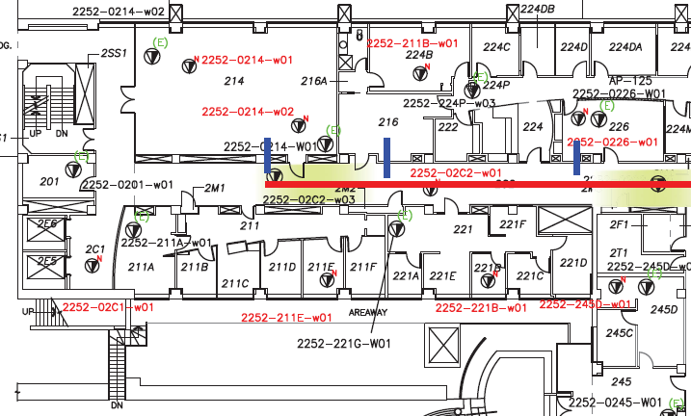
AP Layout Example: MSB, 2nd Floor
Ten (10) existing APs in immediate area
Eleven (11) APs in updated wireless network design
Nine (9) new locations indicated in red
Eight (8) existing denoted in green
Two (2) existing APs (shaded areas) will be unchanged

Slide 8
Delivery Timeline - Campus
Medical Sciences (322)
654 Minnesota (20)
Health Sciences East (212)
School of Dentistry (117)
ACC Parking (4)
Nursing (95)
Health Sciences West (187)
IRM (63)
Mission Bay Towers (controller)
MB Housing: 3rd Ave (20)
MB Housing: 5th Avenue (30)
MB Housing: 145 Irving (20)
Planned scheduled through FY18

Slide 9
Delivery Timeline – Medical Center
350 Parnassus (60)
654 Minnesota (20)
MTZ Dialysis (5)
1701 Divisadero (28)
2255 Post St (8)
2233 Post St (15)
2380 Sutter (9)
2330 Post St (29)
1545 Divisadero (28)
Mount Zion Hospital (151)
2356 Sutter (20)
3360 Geary (20)
MTZ Cancer Center (47)
Planned scheduled through FY18
Project Manager: Joey Devasi

Slide 10
Questions? (Here are some suggestions)
Why do we have to refresh the wireless network?
How do I stay informed regarding delivery dates for ( my building ) ?
Why do we need a new layout? Why can’t we just replace the old device with the new device?
Is this only Campus buildings?
How many APs will be going into my area? How do I request more?
Why are we doing this now?
What does “location relevant content and services” mean?

