Slide 1
Migrating your process to DocuSign
October 2014
Jill Cozen-Harel
DocuSign Introduction
UCCSC
July 8, 2014

Slide 2
Topics
Is your process right for DocuSign?
Documenting current state
Translating to DocuSign
Communicating to users
Resources and Support

Slide 3
Why DocuSign?
DocuSign is a web-based electronic signature and workflow management application.
It is becoming the UCSF campus solution for electronic signatures.
It will significantly speed up processes that require signatures.
Users can sign from anywhere and on any device
PAIN POINT: The current process of printing a form, signing it, scanning it, and then emailing it takes up too much administrative time and decreases efficiency.

Slide 4
How DocuSign works
DocuSign is a cloud-based application – all routing and signing occurs within the DocuSign interface
DocuSign is integrated with MyAccess
Flexible workflow
Email notifications when actions are required
Allows for automated reminders and expirations
All users in workflow can view real-time tracking status

Slide 5
When shouldn’t you use DocuSign?
Documents require significant editing or comments
Routing requires complex role or recipient flexibility

Slide 6
Which DocuSign?
We have two instances of DocuSign:
DocuSign
Campus usage
DocuSign for Patients
Includes potential for integration with APeX/EPIC and ImageNow
Contact Jill Cozen-Harel to discuss
Also possible: API Integrations with DocuSign
Contact Jill Cozen-Harel to discuss

Slide 7
Read on for regular DocuSign
Not DocuSign for Patients
Not setting up an integration with another system to make an API call to DocuSign

Slide 8
Ready to get started?
Document your current process and begin to map out your DocuSign template
Simultaneously, reach out to Jill Cozen-Harel – jill.cozen-harel@ucsf.edu or 415.476.4781 to walk through your steps

Slide 9
Documenting current state
Answer the following questions:
Repeatability and flexibility
Is the form itself static or dynamic? Will you always be using the same form?
Is the workflow repeatable, even if the specific individuals who fill given roles may change?
Process initiation
Form posted on campus website?
Sent manually?
Freeform or tagged signing
Designate where, on the form, the recipients will place their signature, name, or other data
Or let them select where to place those fields

Slide 10
Documenting current state: routing
DocuSign handles all workflow routing – no user will need to forward a document or a link via email to another recipient.
Note that all recipients, regardless of role, will automatically receive an email with a link to the signed document when it is completed. This does not need to be in the workflow.
What is the order of the process?
Who sends the form?
If it will be initiated by a webform, you will still need to designate a “sender” as the contact person to reply if recipients have questions
Who receives it, regardless of whether they sign or enter data or just get a copy?
In what order?

Slide 11
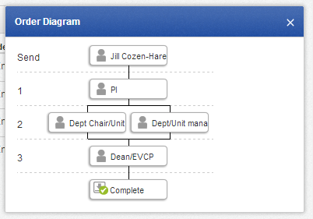
Documenting current state: routing
Determine the roles and order of each recipient
Parallel or sequential routing, or combination
Roles:
Each recipient needs
a role name (PI or Dept
Chair in above example)
Each role can be
hard-coded to always go to
the same person or can be
open, so that the name and
email of that role is entered each time that template is used
Are all roles signers? Or do some roles only receive copies of the document?

Slide 12
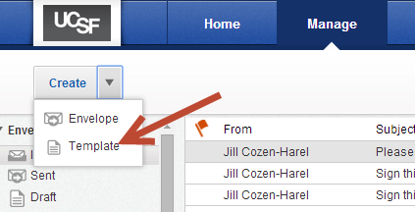
Translating to DocuSign
Repeatability and flexibility
If your process is repeatable, you will create a DocuSign template. To do this, click on the Manage tab at the top of the screen. Then click Create and select template from the drop-down.
Step 1
Step 2

Slide 13
Translating to DocuSign
Process initiation
Form posted on campus website?
If it will be a self-service form, this will become a DocuSign PowerForm; contact jill.cozen-harel@ucsf.edu during or after setting up the template
The template is still the basis for routing for signing, cc’s, and other approvals for after the initial signer initiates the form
Sent manually?
→ As long as it’s a repeatable process, you will create a DocuSign template and then use that template each time you send the document

Slide 14
Translating to DocuSign
Freeform or tagged signing
If freeform, you will only need to designate the workflow for your template
If tagged signing, DO NOT FORGET TO CLICK NEXT AFTER COMPLETING THE ROUTING SECTION
(Details in upcoming slides)

Slide 15
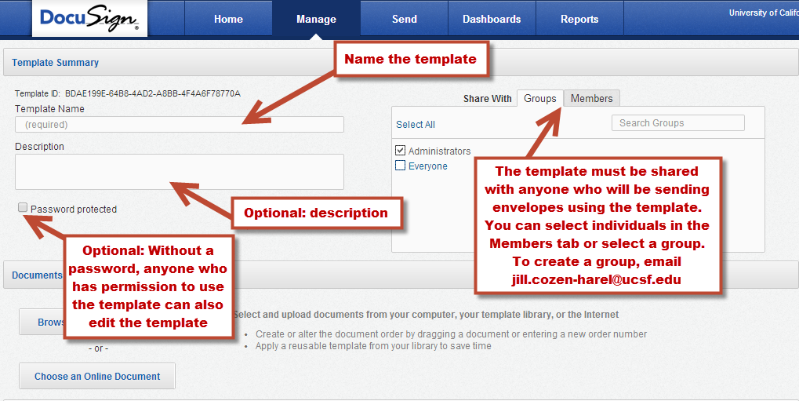
Template set up – title and sharing

Slide 16
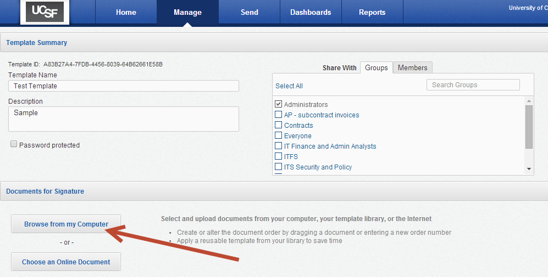
Uploading Document(s)
Click on Browse from my Computer and choose a document.
File can be a MS Word® 2003, 2007, 2010, MS Excel® 2003, 2007, 2010, MSPowerPoint® 2003, 2007, 2010, text file (.txt), rich text format (.rtf), image file formats (.png, .jpg, .gif and .tif), or PDF (.pdf) file
You can select multiple documents, but the total file size cannot exceed 25MB.
You can drag the files or change the order number to rearrange the order of the files.
You can use a form in which the content will change but the formatting will stay the same and replace the specific document each time you use it, while retaining the location of the tags

Slide 17
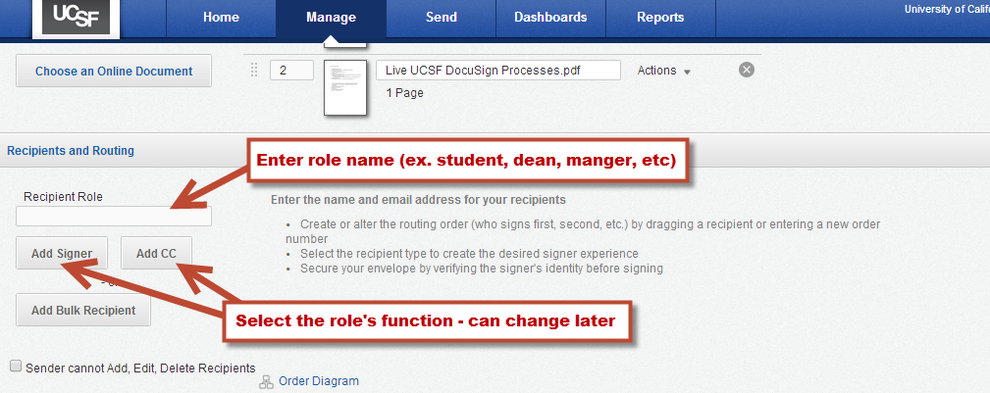
Workflow: roles and actions

Slide 18
Workflow: roles and actions
Continue to fill out routing – details on following slides
Leave name and email blank for roles that will have a different recipient in each envelope
Enter the recipient’s name and email only the same recipient will always fill that role

Slide 19
Workflow: roles and actions
What action applies to each role?
Function | Action (DocuSign Term)
Signing or inputting ANY information onto a form or document | Sign
For a tablet or kiosk (in-person) signing session: the sender acts as the "signing host" and the signer is places in the "signer name" slot | Sign in person
Receive a copy of the envelope, for viewing only | Receive copy
Fill in name/email for subsequent recipient(s); can also make any changes to envelope, including adding or deleting from routing, documents, or tags. Note that this user cannot correct changes after submitting them; must be a UCSF sending-enabled user. | Manage envelope

Slide 20
Workflow: roles and actions
Function | Action (DocuSign Term)
Fill in name and email for subsequent recipients; can also void envelope or correct recipient names or emails until those recipients have taken action | Manage recipients
Fill in name and email for subsequent recipients; can also void envelope but cannot correct recipient information once sent | Address recipients
Receive a copy of the envelope, for viewing only; will not route to next recipient until this user has actually viewed document | Acknowledge receipt
*more details here

Slide 21
Customizing email messages

Slide 22
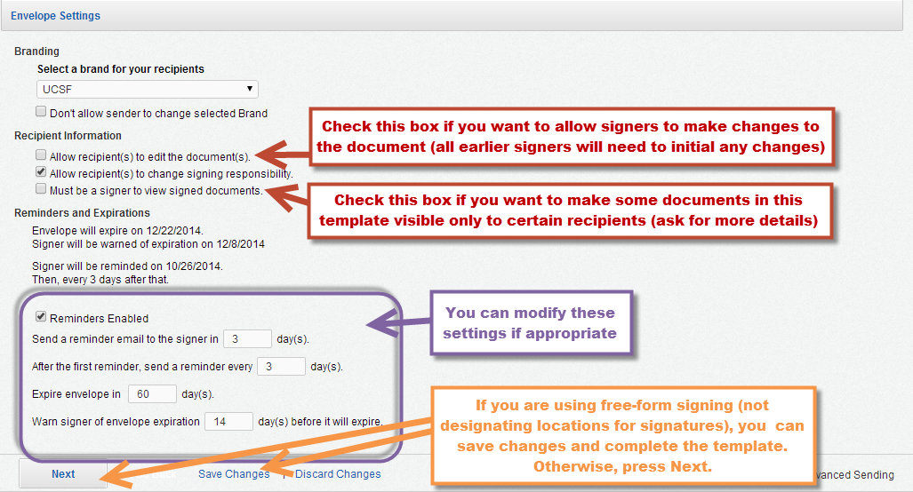
Settings

Slide 23
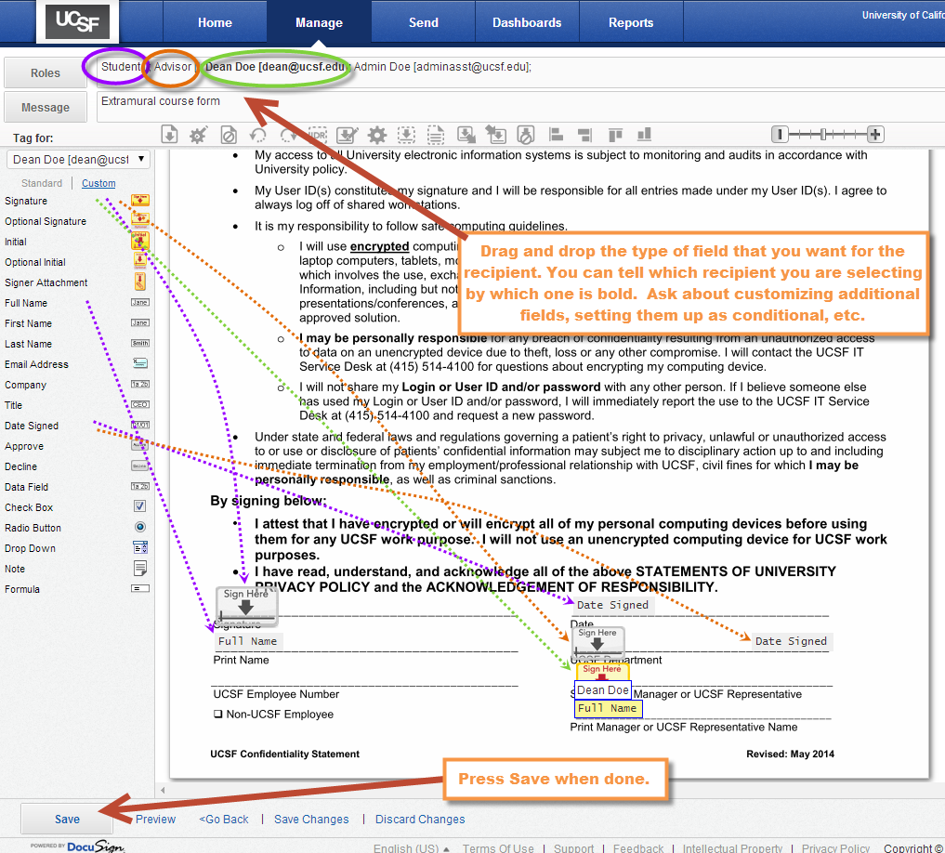
Assigning tags and data fields

Slide 24
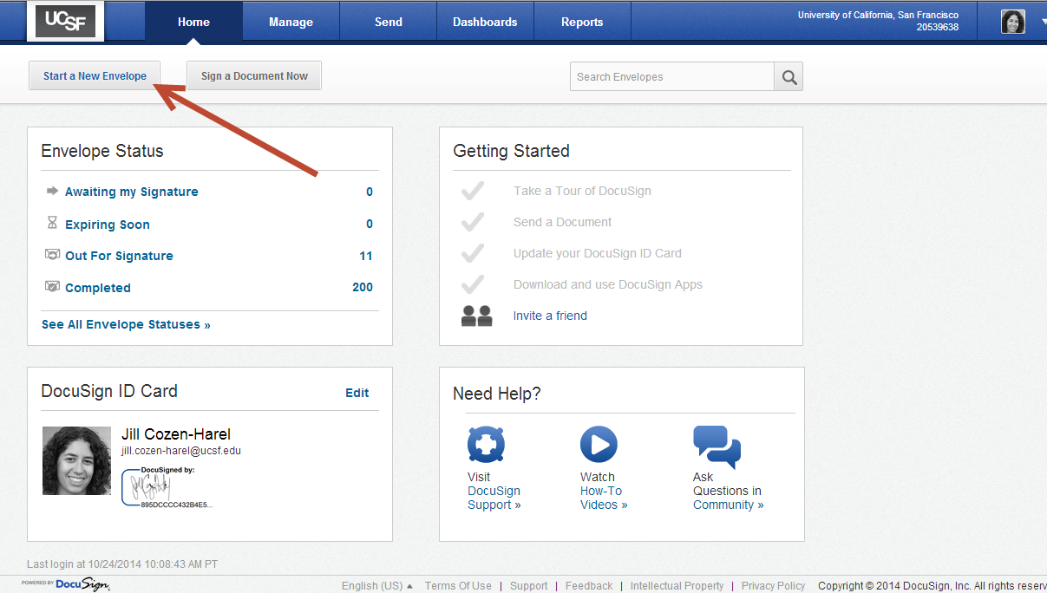
Sending the envelopes
Log into DocuSign via MyAccess
On the DocuSign Home Screen, select Start a New Envelope

Slide 25
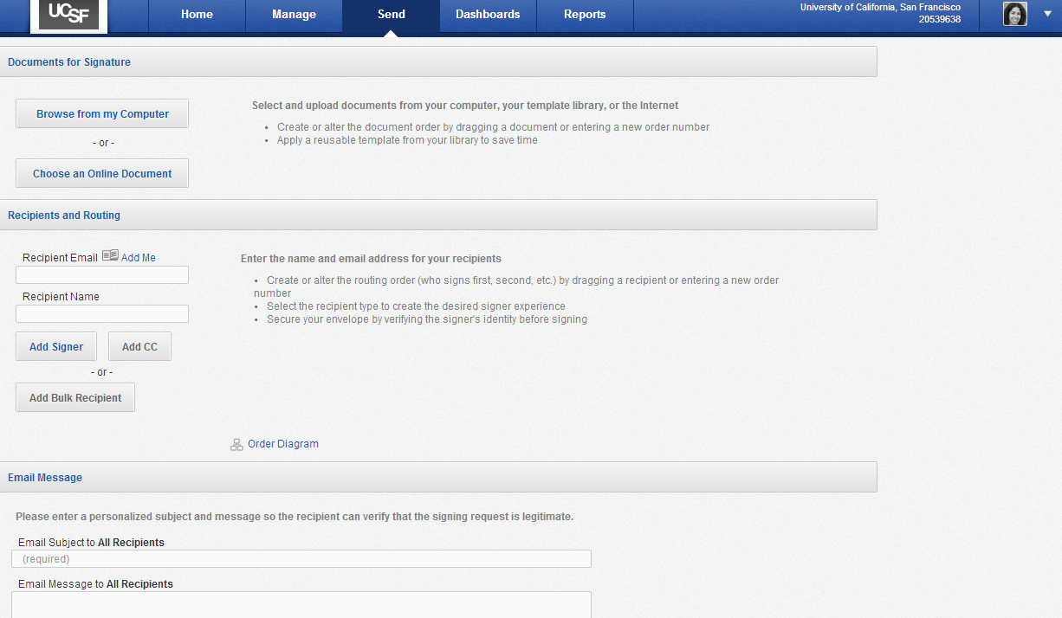
Selecting the template
Click on Choose an Online Document

Slide 26
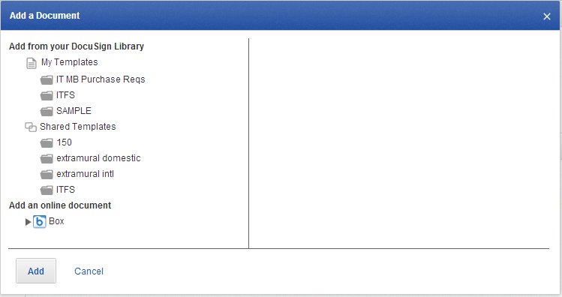
Selecting the template
Select either ‘My Templates’ or ‘Shared Templates’ or a subfolder where you may have placed the template

Slide 27
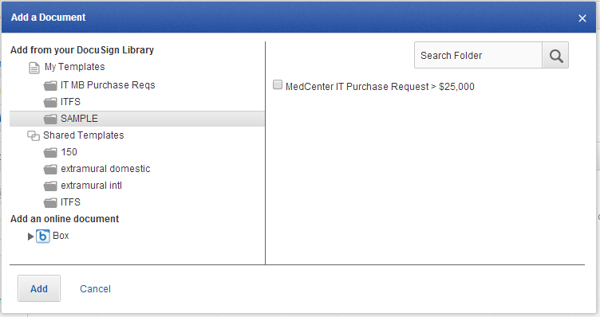
Selecting the Template
Check the box to select the template and then click Add

Slide 28
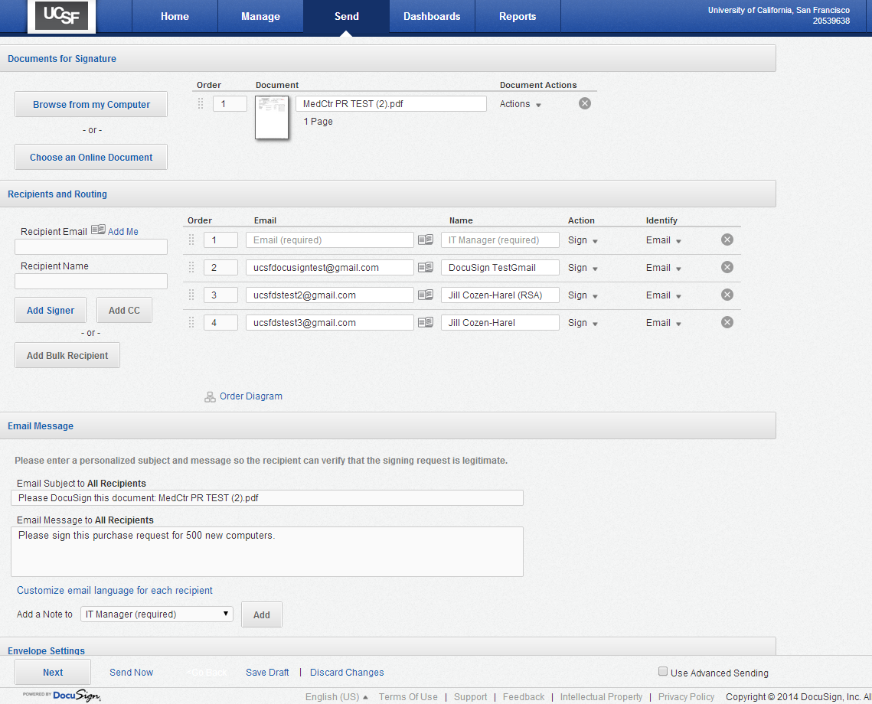
Sending envelope with template
IT Manager = role that needs recipient name and email to be entered
Document, tagging, routing, and email messaging are all imported. You can customize this envelope by filling in any blank recipients, adding another document, editing the email message, or modifying the workflow. When ready, press Send Now.

Slide 29
Tracking Progress
From anywhere in DocuSign, click on the Manage tab.

Slide 30
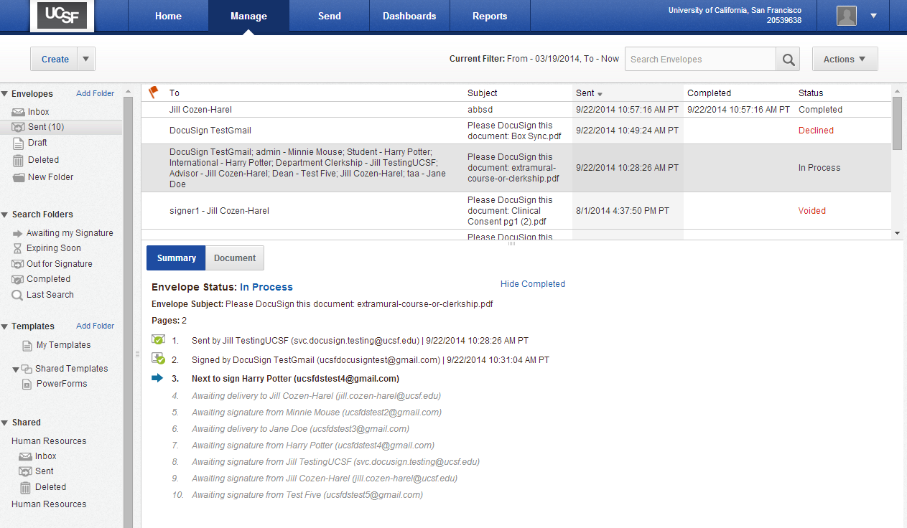
Tracking Progress
(2)Then single-click on the envelope – either scroll through the folder or use the search function
(1) Choose the appropriate folder to find the envelope (Inbox = you are a recipient; Sent = you sent it)
Completed step
Bold – current step
Italics - Future step

Slide 31
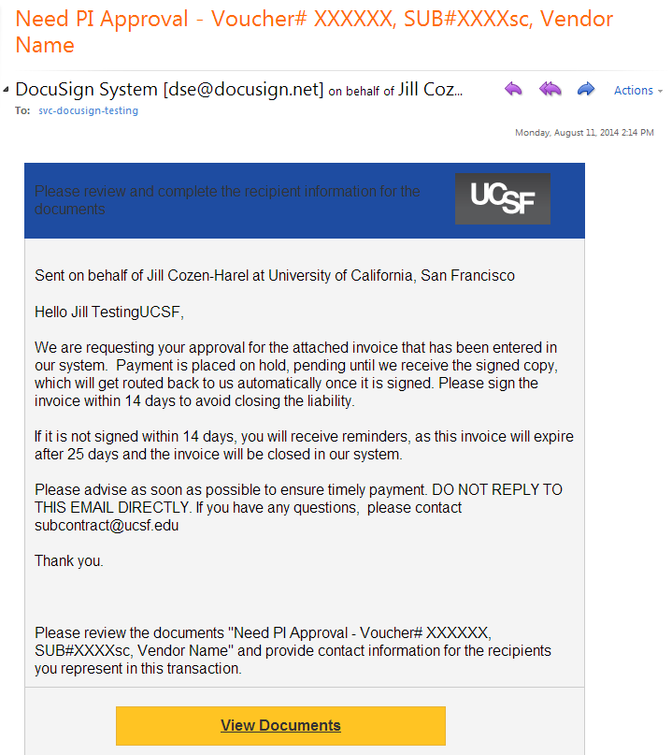
As a recipient
Tell your colleagues or business partners to look out for emails like this one. Outlook will list the sender’s name, but it will always be formatted in this way.
Signer receives an email notification that there is an invoice to be signed

Slide 32
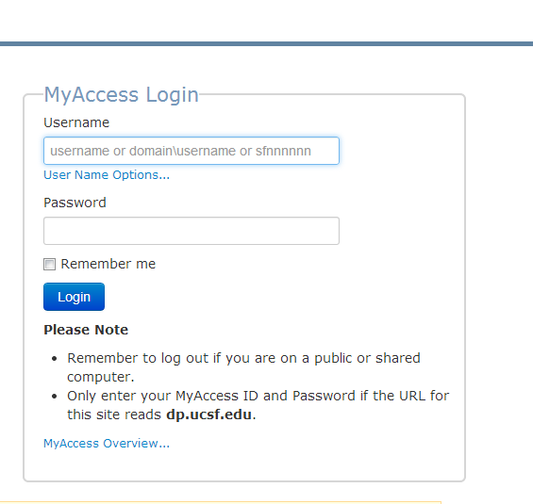
Depending on their role in the DocuSign envelope, they may be directed to MyAccess
Step 1 Step 2

Slide 33
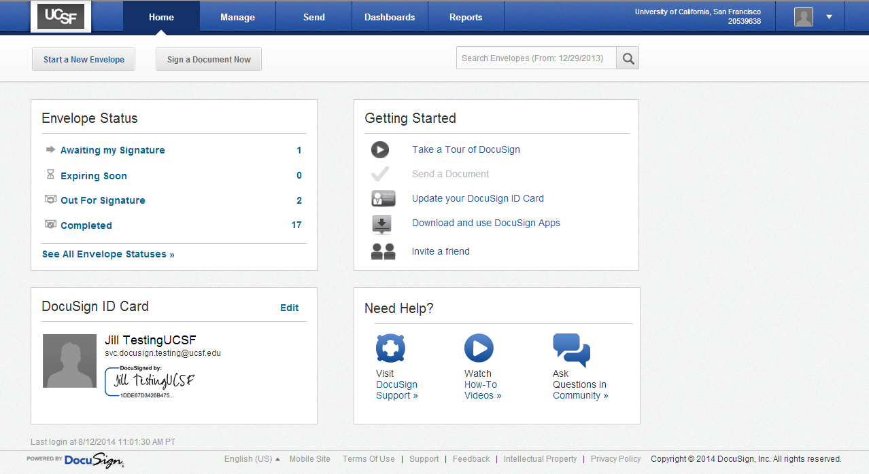
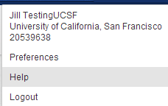
Home Page
UCSF DocuSign help
DocuSign ID Card:
Displays your full name, email address, signature, and photo if you upload it

Slide 34
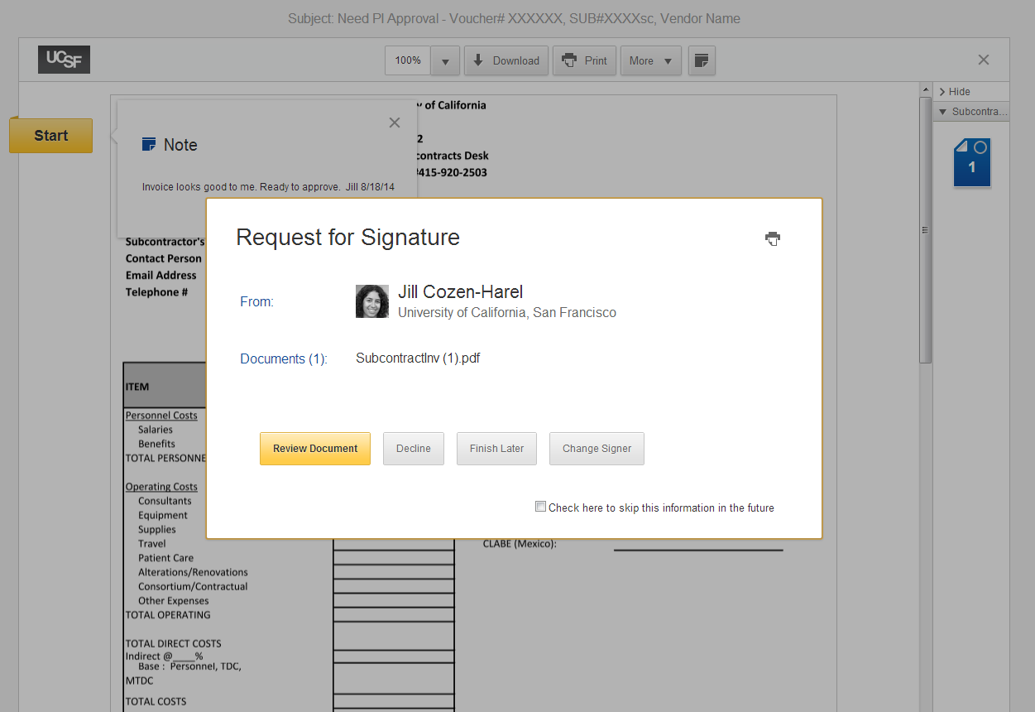
If they are a signer, they will be directed to the signing screen.

Slide 35
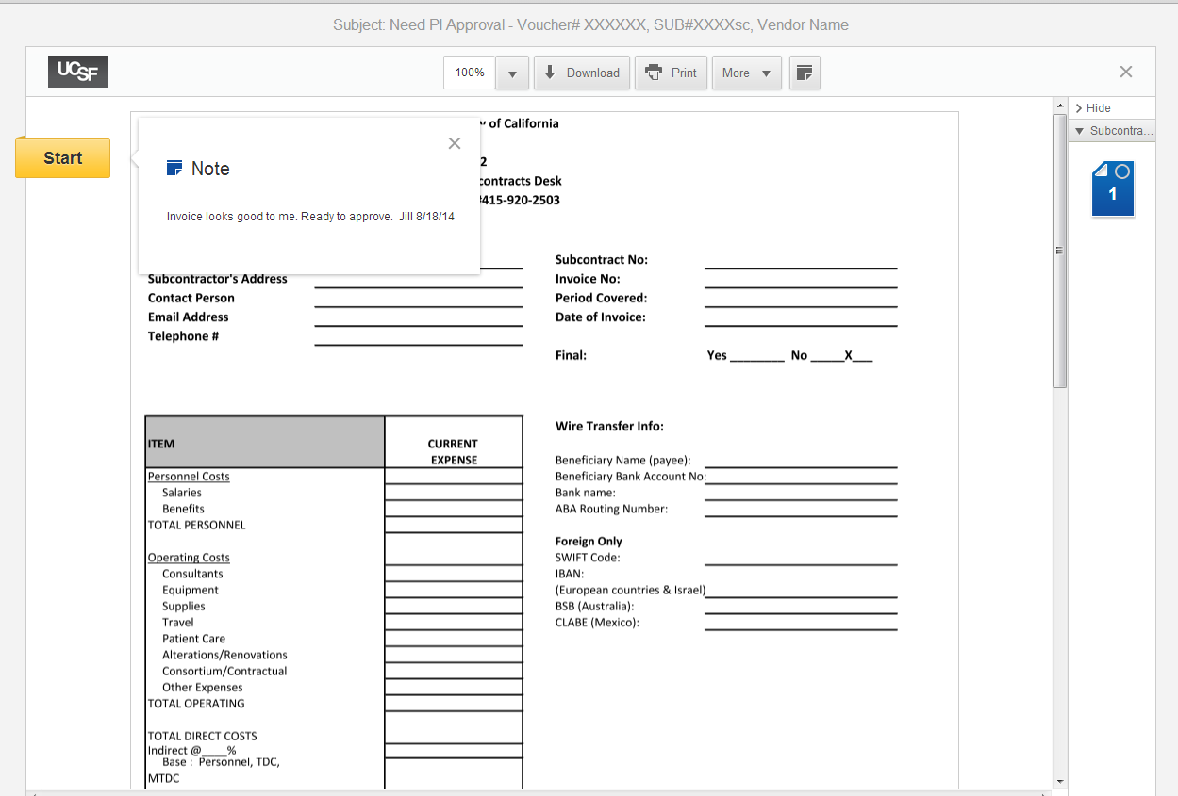
Either just scroll down to the bottom of the page for signing or click the yellow Start tag to take you there.

Slide 36
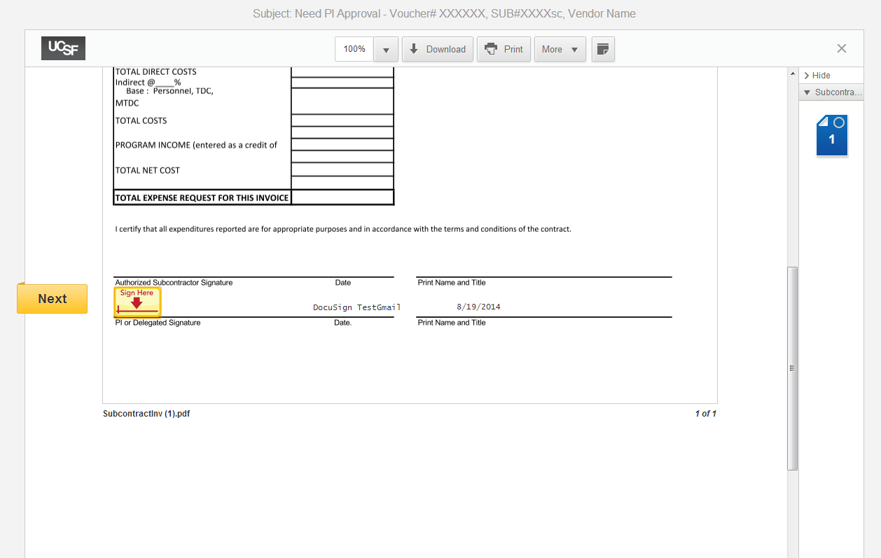

Slide 37
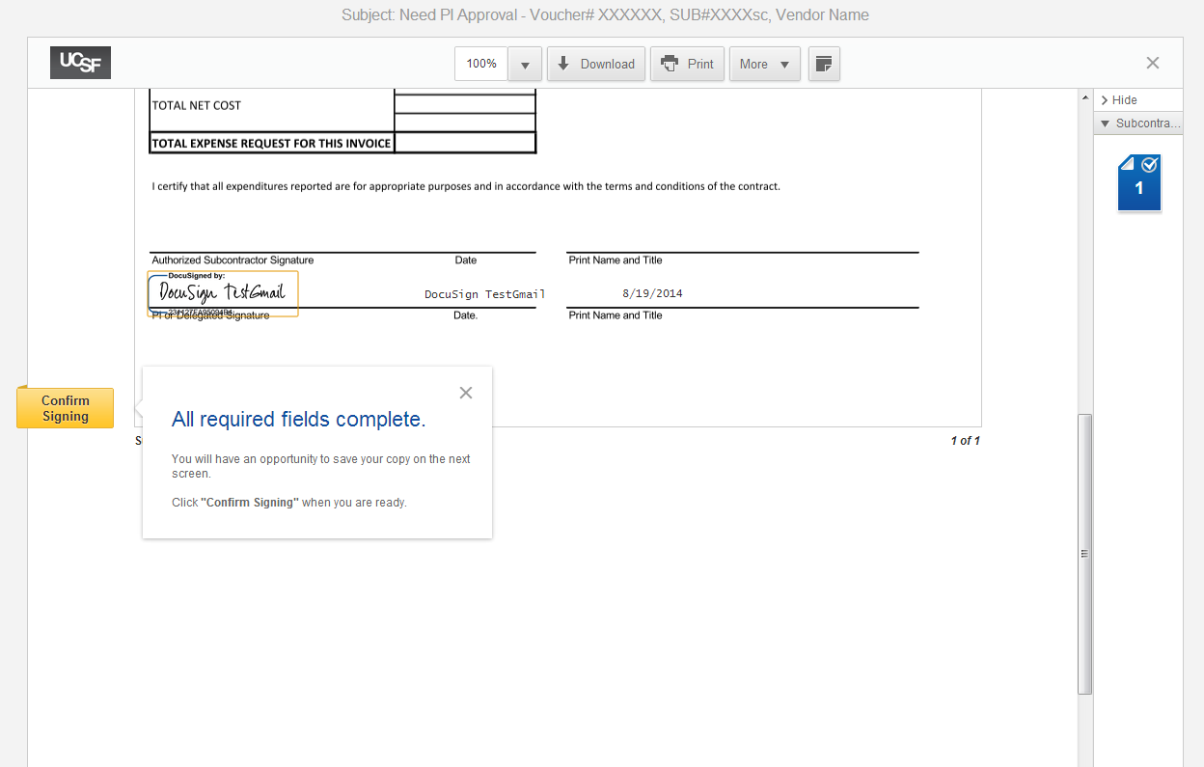
Done! The invoice has now been routed to the next signer. You and any other recipients can now log in to view signed invoice.

Slide 38
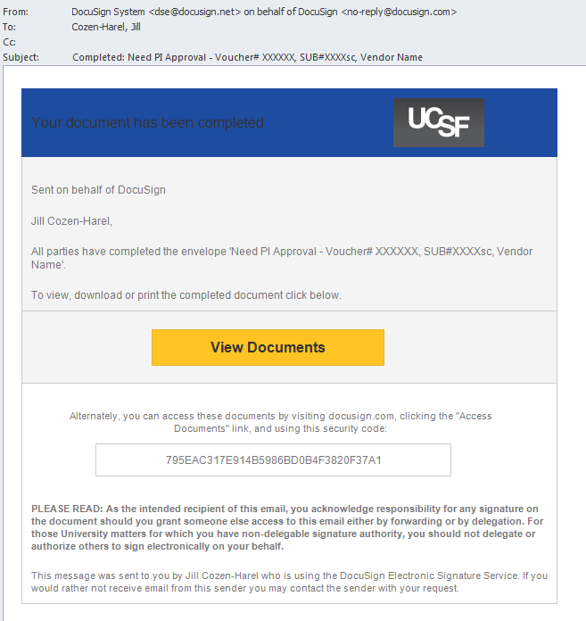
Once the workflow is complete, the sender and all recipients receive this email with a secure link to log in and view the invoice.

Slide 39
Communicating to users
Alert your signers and other recipients (cc, manage envelope, others) about the upcoming change
Send them a sample or screenshots
Make sure that everyone understands your workflow
Let them know that they do not need to forward to the next person – DocuSign handles all routing
Set up any folder sharing structures that might be needed – submit a ticket to have grant a coworker access to your DocuSign folders, so that they can see what you have sent or received

Slide 40
Resources and Support
General UCSF DocuSign Resources
https://it.ucsf.edu/services/electronic-signature-docusign
Jill Cozen-Harel
Jill.cozen-harel@ucsf.edu
415.476.4781

