Slide 1
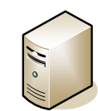
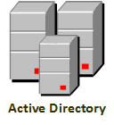
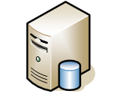
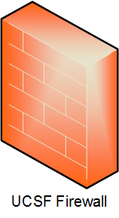
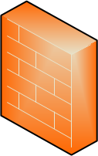
Title
UCSF Network
h
Title of system MCB45646
Device Name
Ports/Protocol
Ports/Protocol
Ports/Protocol
Ports/Protocol
Ports/Protocol
Ports/Protocol
Ports/Protocol
Ports/Protocol
Created By:
Date Updated:

